Slide 1


Data Mining and Data Warehousing CSE-4107
Md. Manowarul Islam
Associate Professor, Dept. of CSE
Jagannath University

Slide 2
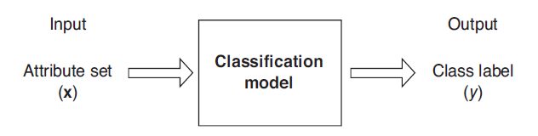
What is classification?
Classification is the task of learning a target function f that maps attribute set x to one of the predefined class labels y
The target function f is known as a classification model

Slide 3
What is classification?
categorical
categorical
continuous
class
One of the attributes is the class attribute
In this case: Cheat
Two class labels (or classes): Yes (1), No (0)

Slide 4
Classification vs. Prediction
Classification
predicts categorical class labels (discrete or nominal)
classifies data (constructs a model) based on the training set and the values (class labels) in a classifying attribute and uses it in classifying new data
Prediction
models continuous-valued functions,
predicts unknown or missing values

Slide 5
Classification vs. Prediction
Descriptive modeling: Explanatory tool to distinguish between objects of different classes (e.g., understand why people cheat on their taxes)
Predictive modeling: Predict a class of a previously unseen record

Slide 6
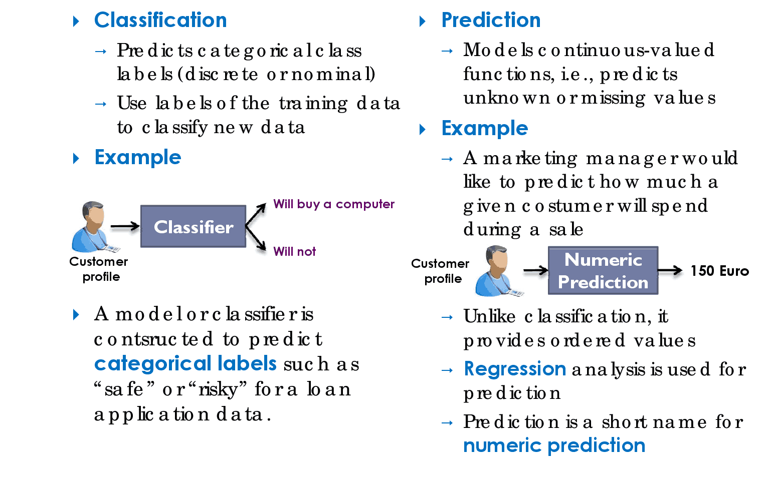
Classification vs. Prediction

Slide 7
Why Classification?
Credit approval
A bank wants to classify its customers based on whether they are expected to pay back their approved loans
The history of past customers is used to train the classifier
The classifier provides rules, which identify potentially reliable future customers
Classification rule:
If age = “31...40” and income = high then credit_rating = excellent
Future customers
Paul: age = 35, income = high ⇒ excellent credit rating
John: age = 20, income = medium ⇒ fair credit rating

Slide 8
Classification—A Two-Step Process
Model construction: describing a set of predetermined classes
Each tuple/sample is assumed to belong to a predefined class, as determined by the class label attribute
The set of tuples used for model construction: training set
The model is represented as classification rules, decision trees, or mathematical formulae

Slide 9
Classification—A Two-Step Process
Model usage: for classifying future or unknown objects
Estimate accuracy of the model
The known label of test samples is compared with the classified result from the model
Accuracy rate is the percentage of test set samples that are correctly classified by the model
Test set is independent of training set, otherwise over-fitting will occur

Slide 10
Model Construction
Classification
Algorithms
Training
Data
Classifier
(Model)
IF rank = ‘professor’
OR years > 6
THEN tenured = ‘yes’

Slide 11
Use the Model in Prediction
Classifier
Testing
Data
Unseen Data
(Jeff, Professor, 4)
Tenured?

Slide 12
Illustrating Classification Task

Slide 13
Decision Tree Classification Task
Decision Tree

Slide 14
Supervised vs. Unsupervised Learning
Supervised learning (classification)
Supervision: The training data (observations, measurements, etc.) are accompanied by labels indicating the class of the observations
New data is classified based on the training set
Unsupervised learning (clustering)
The class labels of training data is unknown
Given a set of measurements, observations, etc. with the aim of establishing the existence of classes or clusters in the data

Slide 15
Classification and prediction : Data Preparation
Data cleaning
Preprocess data in order to reduce noise and handle missing values
Relevance analysis (feature selection)
Remove the irrelevant or redundant attributes
Data transformation
Generalize and/or normalize data
numerical attribute income ⇒ categorical {low,medium,high}
normalize all numerical attributes to [0,1]

Slide 16
Evaluating Classification Methods
Predictive accuracy
Speed
time to construct the model
time to use the model
Robustness
handling noise and missing values
Scalability
efficiency in disk-resident databases
Interpretability:
understanding and insight provided by the model
Goodness of rules (quality)
decision tree size
compactness of classification rules

Slide 17
Evaluation of classification models
Counts of test records that are correctly (or incorrectly) predicted by the classification model
Confusion matrix
Predicted Class
 | Class = 1 | Class = 0
Class = 1 | f₁₁ | f₁₀
Class = 0 | f₀₁ | f₀₀
Actual Class

Slide 18
Classification Techniques
Decision Tree based Methods
Rule-based Methods
Memory based reasoning
Neural Networks
Naïve Bayes and Bayesian Belief Networks
Support Vector Machines

Slide 19
Decision Trees
Decision tree
A flow-chart-like tree structure
Internal node denotes a test on an attribute
Branch represents an outcome of the test
Leaf nodes represent class labels or class distribution

Slide 20
Example of a Decision Tree
categorical
categorical
continuous
class
Splitting Attributes
Refund
Yes
No
Test outcome
NO
MarSt
Single, Divorced
Married
TaxInc
NO
< 80K
> 80K
NO
YES
Class labels
Training Data
Model: Decision Tree

Slide 21
Another Example of Decision Tree
categorical
categorical
continuous
class
MarSt
Single, Divorced
Married
NO
Refund
Yes
No
NO
TaxInc
< 80K
> 80K
NO
YES
There could be more than one tree that fits the same data!

Slide 22
Apply Model to Test Data
Start from the root of tree.
Test Data
Refund | Marital Status | Taxable Income | Cheat
No | Married | 80K | ?
Refund
Yes
No
NO
MarSt
Single, Divorced
Married
TaxInc
NO
< 80K
> 80K
NO
YES

Slide 23
Apply Model to Test Data
Test Data
Refund | Marital Status | Taxable Income | Cheat
No | Married | 80K | ?
Refund
Yes
No
NO
MarSt
Single, Divorced
Married
TaxInc
NO
< 80K
> 80K
NO
YES

Slide 24
Apply Model to Test Data
Test Data
Refund | Marital Status | Taxable Income | Cheat
No | Married | 80K | ?
Refund
Yes
No
NO
MarSt
Single, Divorced
Married
TaxInc
NO
< 80K
> 80K
NO
YES

Slide 25
Apply Model to Test Data
Test Data
Refund | Marital Status | Taxable Income | Cheat
No | Married | 80K | ?
Refund
Yes
No
NO
MarSt
Single, Divorced
Married
TaxInc
NO
< 80K
> 80K
NO
YES

Slide 26
Apply Model to Test Data
Test Data
Refund | Marital Status | Taxable Income | Cheat
No | Married | 80K | ?
Refund
Yes
No
NO
MarSt
Single, Divorced
Married
TaxInc
NO
< 80K
> 80K
NO
YES

Slide 27
Apply Model to Test Data
Test Data
Refund | Marital Status | Taxable Income | Cheat
No | Married | 80K | ?
Refund
Yes
No
NO
MarSt
Single, Divorced
Married
Assign Cheat to “No”
TaxInc
NO
< 80K
> 80K
NO
YES

Slide 28
General Structure of Hunt’s Algorithm
Let D_{t} be the set of training records that reach a node t
General Procedure:
If D_{t} contains records that belong the same class y_{t}, then t is a leaf node labeled as y_{t}
If D_{t} contains records with the same attribute values, then t is a leaf node labeled with the majority class y_{t}
If D_{t} is an empty set, then t is a leaf node labeled by the default class, y_{d}
If D_{t} contains records that belong to more than one class, use an attribute test to split the data into smaller subsets.
Recursively apply the procedure to each subset.
D_{t}
?

Slide 29
Hunt’s Algorithm
Don’t Cheat

Slide 30
Hunt’s Algorithm
Refund
Don’t Cheat
Yes
No
Don’t Cheat
Don’t Cheat

Slide 31
Hunt’s Algorithm
Refund
Don’t Cheat
Yes
No
Don’t Cheat
Don’t Cheat
Refund
Yes
No
Don’t Cheat
Marital Status
Single, Divorced
Married
Cheat
Don’t Cheat

Slide 32
Hunt’s Algorithm
Refund
Don’t Cheat
Yes
No
Don’t Cheat
Don’t Cheat
Refund
Refund
Yes
No
Yes
No
Don’t Cheat
Marital Status
Don’t Cheat
Marital Status
Single, Divorced
Married
Single, Divorced
Married
Cheat
Don’t Cheat
Taxable Income
Don’t Cheat
< 80K
>= 80K
Don’t Cheat
Cheat

Slide 33
Tree Induction
Finding the best decision tree is NP-hard
Greedy strategy.
Split the records based on an attribute test that optimizes certain criterion.
Many Algorithms:
Hunt’s Algorithm (one of the earliest)
CART
ID3, C4.5
SLIQ,SPRINT

Slide 34
Classification by Decision Tree Induction
Decision tree
A flow-chart-like tree structure
Internal node denotes a test on an attribute
Branch represents an outcome of the test
Leaf nodes represent class labels or class distribution
Decision tree generation consists of two phases
Tree construction
At start, all the training examples are at the root
Partition examples recursively based on selected attributes
Tree pruning
Identify and remove branches that reflect noise or outliers
Use of decision tree: Classifying an unknown sample
Test the attribute values of the sample against the decision tree

Slide 35
Training Dataset

Slide 36
Output: A Decision Tree for “buys_computer”
age?
<=30
overcast
>40
30..40
student?
yes
credit rating?
no
yes
excellent
fair
no
yes
no
yes

Slide 37
Algorithm for Decision Tree Induction
Basic algorithm (a greedy algorithm)
Tree is constructed in a top-down recursive divide-and-conquer manner
At start, all the training examples are at the root
Attributes are categorical (if continuous-valued, they are discretized in advance)
Samples are partitioned recursively based on selected attributes
Test attributes are selected on the basis of a heuristic or statistical measure (e.g., information gain)
Conditions for stopping partitioning
All samples for a given node belong to the same class
There are no remaining attributes for further partitioning – majority voting is employed for classifying the leaf
There are no samples left

Slide 38
Attribute Selection Measure:
Information Gain (ID3/C4.5)
Select the attribute with the highest information gain
age?
<=30
overcast
>40
30..40
student?
yes
credit rating?
no
yes
excellent
fair
no
yes
no
yes

Slide 39
Attribute Selection Measure:
Let D, the data partition, be a training set of class-labeled tuples.
m distinct classes, C_{i} (for i = 1,…,m).
C_{i, D} be the set of tuples in D belongs to class C_{i}
|C_{i, D}| and |D| number of tuples in C_{i, D} and D

Slide 40
Attribute Selection Measure:
Let p_{i} be the probability that an arbitrary tuple in D belongs to class C_{i}, estimated by
p_{i} = |C_{i, D}|/|D|
Expected information (entropy) needed to classify a tuple in D:

Slide 41
Training Dataset
The class label attribute, buys Computer
Two distinct values (yes, no);
There are two distinct classes (that is, m = 2).
Let class C₁ correspond to yes and class C₂ correspond to no.
There are nine tuples of class yes and five tuples of class no.

Slide 42
Attribute Selection: Information Gain
Class C1: buys_computer = “yes”
Class C2: buys_computer = “no”

Slide 43
Attribute Selection: Information Gain
Suppose we want to partition the tuples in D on some attribute A having v distinct values , {a₁, a₂, … , a_{v}}
Attribute A can be used to split D into v partitions or subsets, {D₁, D₂, … , D_{v}},
Where D_{j} contains those tuples in D that have outcome a_{j} of A.
Information needed (after using A to split D into v partitions) to classify D:
Information gained by branching on attribute A
Notes:
I : the expected information needed to classify a given sample
E (entropy) : expected information based on the partitioning into subsets by A

Slide 44
Attribute Selection: Information Gain
Class C1: buys_computer = “yes”
Class C2: buys_computer = “no”
Age | Tuple | C1(Y) | C2(N)
<=30 | 5(14) | 2 | 3
31…40 | 4(14) | 4 | 0
>40 | 5(14) | 3 | 2

Slide 45
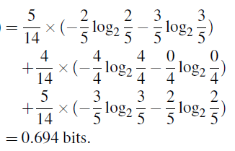
Attribute Selection: Information Gain
Age | Tuple | C1(Y) | C2(N)
<=30 | 5(14) | 2 | 3
31…40 | 4(14) | 4 | 0
>40 | 5(14) | 3 | 2

Slide 46
Attribute Selection: Information Gain

Slide 47
Splitting the samples using age
age?
<=30
>40
30...40
labeled yes

Slide 48
Output: A Decision Tree for “buys_computer”
age?
<=30
overcast
>40
30..40
student?
yes
credit rating?
no
yes
excellent
fair
no
yes
no
yes

Slide 49
Gain Ratio for Attribute Selection (C4.5)
The information gain measure is biased toward tests with many outcomes
consider an attribute that acts as a unique identifier, such as product_ID.
split on product_ID would result in a large number of partitions
Info_{product_ID}(D) = 0.
Information gained by partitioning on this attribute is maximal.
Such a partitioning is useless for classification.

Slide 50

Gain Ratio for Attribute Selection (C4.5)
Information gain measure is biased towards attributes with a large number of values
C4.5 (a successor of ID3) uses gain ratio to overcome the problem (normalization to information gain)

Slide 51
Gain Ratio for Attribute Selection (C4.5)
Income | Tuple
low | 4(14)
medium | 6(14)
high | 4(14)

Slide 52

Gain Ratio for Attribute Selection (C4.5)
Income | Tuple
low | 4(14)
medium | 6(14)
high | 4(14)
Ex. gain_ratio(income) = 0.029/0.926 = 0.031
The attribute with the maximum gain ratio is selected as the splitting attribute

Slide 53
Thank you

